Slide 1
Cleaning data, Working with missing data, Boolean Indexing

Slide 2
Cleaning Data
Wrong Data
"Wrong data" does not have to be "empty cells" or "wrong format", it can just be wrong, like if someone registered "199" instead of "1.99".
Sometimes you can spot wrong data by looking at the data set, because you have an expectation of what it should be.
If you take a look at our data set, you can see that in row 7, the duration is 450, but for all the other rows the duration is between 30 and 60.
It doesn't have to be wrong, but taking in consideration that this is the data set of someone's workout sessions, we conclude with the fact that this person did not work out in 450 minutes

Slide 3
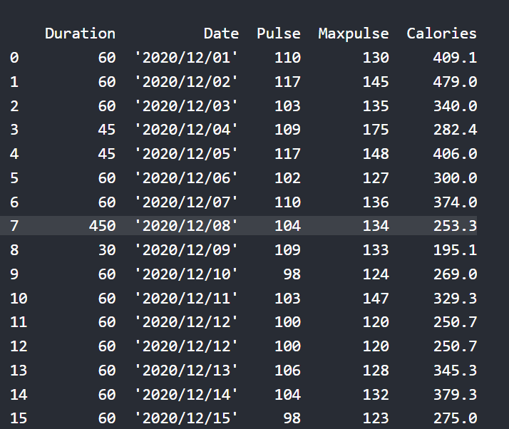

Slide 4
Replacing Values
One way to fix wrong values is to replace them with something else.
In our example, it is most likely a typo, and the value should be "45" instead of "450", and we could just insert "45" in row 7:
ExampleGet your own Python Server
Set "Duration" = 45 in row 7:
df.loc[7, 'Duration'] = 45

Slide 5
For small data sets you might be able to replace the wrong data one by one, but not for big data sets.
To replace wrong data for larger data sets you can create some rules, e.g. set some boundaries for legal values, and replace any values that are outside of the boundaries.
Example
Loop through all values in the "Duration" column.
If the value is higher than 120, set it to 120:
for x in df.index:
if df.loc[x, "Duration"] > 120:
df.loc[x, "Duration"] = 120

Slide 6
Removing Rows
Another way of handling wrong data is to remove the rows that contains wrong data.
This way you do not have to find out what to replace them with, and there is a good chance you do not need them to do your analyses.
Example
Delete rows where "Duration" is higher than 120:
for x in df.index:
if df.loc[x, "Duration"] > 120:
df.drop(x, inplace = True)

Slide 7
Working with missing data
Missing Data can occur when no information is provided for one or more items or for a whole unit.
Missing Data is a very big problem in real life scenario.
Missing Data can also refer to as NA(Not Available) values in pandas.
import pandas as pd
import numpy as np
dict = {'First Score':[100, 90, np.nan, 95],
'Second Score': [30, 45, 56, np.nan],
'Third Score':[np.nan, 40, 80, 98]}
df = pd.DataFrame(dict)
df.isnull()

Slide 8
Example:
import pandas as pd
import numpy as np
dict = {'First Score':[100, 90, np.nan, 95],
'Second Score': [30, 45, 56, np.nan],
'Third Score':[np.nan, 40, 80, 98]}
df = pd.DataFrame(dict)
df.fillna(0)
Example:
import pandas as pd
import numpy as np
dict = {'First Score':[100, 90, np.nan, 95],
'Second Score': [30, np.nan, 45, 56],
'Third Score':[52, 40, 80, 98],
'Fourth Score':[np.nan, np.nan, np.nan, 65]}
df = pd.DataFrame(dict)
df.dropna()

Slide 9
import pandas as pd
dict = {'name':["aparna", "pankaj", "sudhir", "Geeku"],
'degree': ["MBA", "BCA", "M.Tech", "MBA"],
'score':[90, 40, 80, 98]}
df = pd.DataFrame(dict)
for i, j in df.iterrows():
print(i, j)
print()

Slide 10
Boolean indexing is a type of indexing which uses actual values of the data in the DataFrame. In boolean indexing, we can filter a data in four ways –
Accessing a DataFrame with a boolean index
Applying a boolean mask to a dataframe
Masking data based on column value
Masking data based on an index value
Accessing a DataFrame with a boolean index :
In order to access a dataframe with a boolean index, we have to create a dataframe in which the index of dataframe contains a boolean value that is “True” or “False”. For Example

Slide 11
Example:
import pandas as pd
dict = {'name':["aparna", "pankaj", "sudhir", "Geeku"],
'degree': ["MBA", "BCA", "M.Tech", "MBA"],
'score':[90, 40, 80, 98]}
df = pd.DataFrame(dict, index = [True, False, True, False])
print(df)
Now we have created a dataframe with the boolean index after that user can access a dataframe with the help of the boolean index.
User can access a dataframe using three functions that is .loc[], .iloc[], .ix[]

Slide 12
Accessing a Dataframe with a boolean index using .loc[]
In order to access a dataframe with a boolean index using .loc[], we simply pass a boolean value (True or False) in a .loc[] function.
Example:
import pandas as pd
dict = {'name':["aparna", "pankaj", "sudhir", "Geeku"],
'degree': ["MBA", "BCA", "M.Tech", "MBA"],
'score':[90, 40, 80, 98]}
df = pd.DataFrame(dict, index = [True, False, True, False])
print(df.loc[True])

Slide 13
Accessing a Dataframe with a boolean index using .iloc[]
import pandas as pd
dict = {'name':["aparna", "pankaj", "sudhir", "Geeku"],
'degree': ["MBA", "BCA", "M.Tech", "MBA"],
'score':[90, 40, 80, 98]}
df = pd.DataFrame(dict, index = [True, False, True, False])
print(df.iloc[True])
Example:
import pandas as pd
dict = {'name':["aparna", "pankaj", "sudhir", "Geeku"],
'degree': ["MBA", "BCA", "M.Tech", "MBA"],
'score':[90, 40, 80, 98]}
df = pd.DataFrame(dict, index = [True, False, True, False])
print(df.iloc[1])

Slide 14
Applying a boolean mask to a dataframe :
import pandas as pd
dict = {'name':["aparna", "pankaj", "sudhir", "Geeku"],
'degree': ["MBA", "BCA", "M.Tech", "MBA"],
'score':[90, 40, 80, 98]}
df = pd.DataFrame(dict, index = [0, 1, 2, 3])
print(df[[True, False, True, False]])

Slide 15
import pandas as pd
data = pd.read_excel(“Medals.xlsx”)
df = pd.DataFrame(data, index = [0, 1, 2, 3, 4, 5, 6,
7, 8, 9, 10, 11, 12])
df[[True, False, True, False, True,
False, True, False, True, False,
True, False, True]]
Masking data based on column value :
import pandas as pd
dict = {'name':["aparna", "pankaj", "sudhir", "Geeku"],
'degree': ["BCA", "BCA", "M.Tech", "BCA"],
'score':[90, 40, 80, 98]}
df = pd.DataFrame(dict)
print(df['degree'] == 'BCA')

Slide 16
Example:
import pandas as pd
data = pd.read_excel(“Medals.xlsx", index_col =“Team\NOC")
print(data[‘Gold'] > 25)
Masking data based on index value :
import pandas as pd
dict = {'name':["aparna", "pankaj", "sudhir", "Geeku"],
'degree': ["BCA", "BCA", "M.Tech", "BCA"],
'score':[90, 40, 80, 98]}
df = pd.DataFrame(dict, index = [0, 1, 2, 3])
mask = df.index == 0
print(df[mask])

Slide 17
import pandas as pd
data = pd.read_excel(“Medals.xlsx")
df = pd.DataFrame(data, index = [0, 1, 2, 3, 4, 5, 6,
7, 8, 9, 10, 11, 12])
mask = df.index > 7
df[mask]

